Slide 1
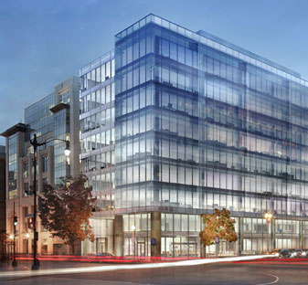
The Office Building
Washington, D.C.
Penn State Architectural Engineering Senior Capstone Project
Brett Miller | Construction Option
Advisor: Dr. Ed Gannon

Slide 2
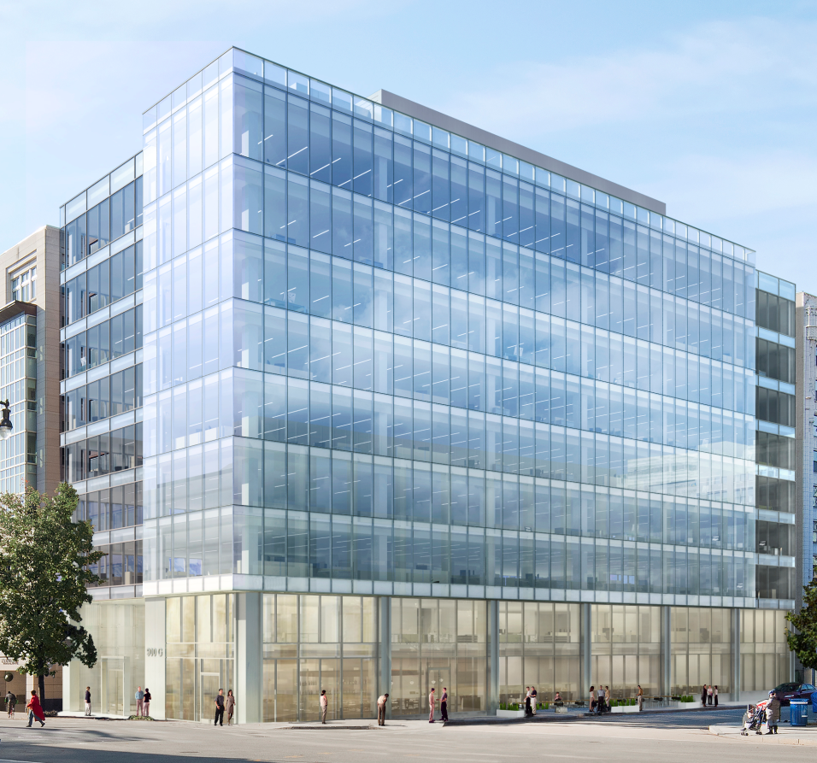
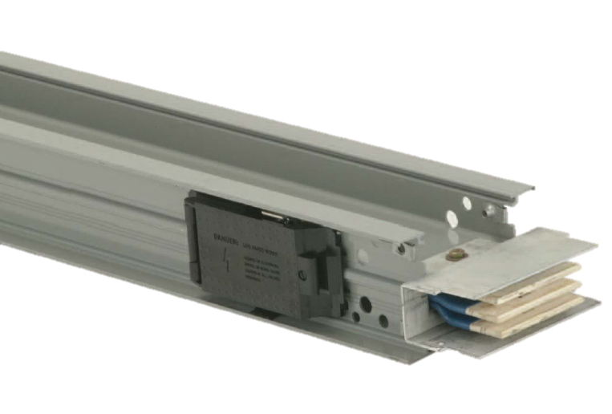
Brett Miller
Construction
Introduction
The Office Building
Washington, D.C.
Research| Retaining Structures
Analysis 2 | Neighboring Foundation Support
Project Overview
Analysis 1 | Foundation Walls
Analysis 3 | Value Engineering
Notes:
I) Project Overview
II)

Slide 3
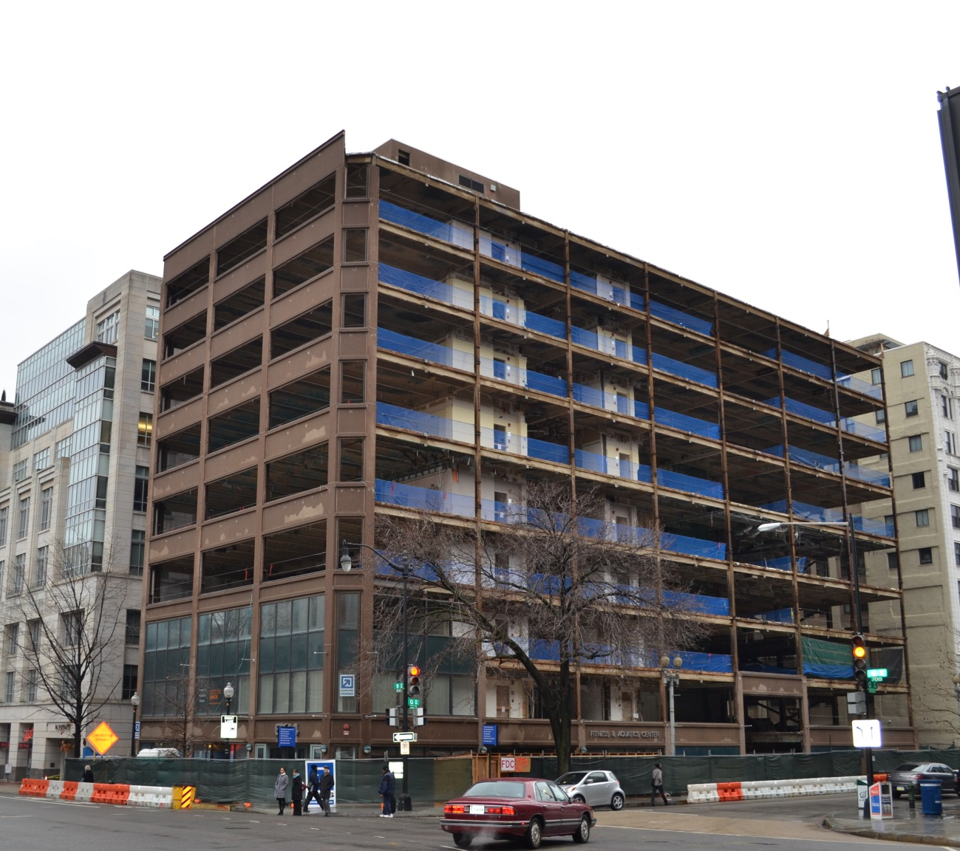
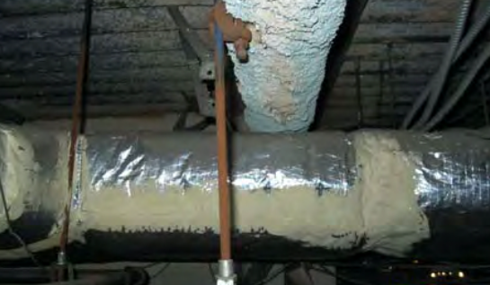
Brett Miller
Construction
Project Overview
The Office Building
Washington, D.C.
Presentation Outline
Project Overview
Research | Retaining Structures
Analysis 1 | Foundation Walls
Cost
Schedule
Conclusion
Analysis 2 | Neighboring Foundation Support
Cost
Schedule
Conclusion
Analysis 3 | Value Engineering
Electrical Breadth | Sizing wire/Busway
Cost
Schedule
Conclusion
Conclusion & Recommendations
Acknowledgements
Project Size | 108,000 SF
Height Above Grade | 9 Stories
Contract Value | $30.5 million
Dates of Construction | March 2013 – March 2015
Occupant | Undetermined
Primary Use | Office Building
Owner | Mid Atlantic Realty
General Contractor | James G. Davis Construction
Architect | Gensler

Slide 4
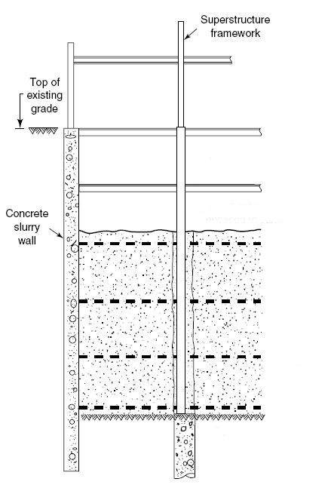
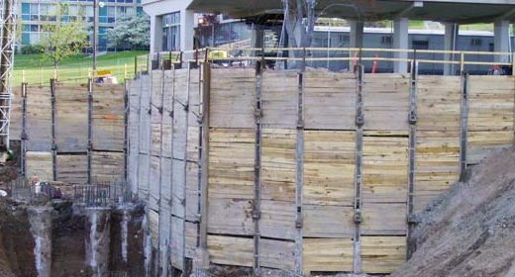
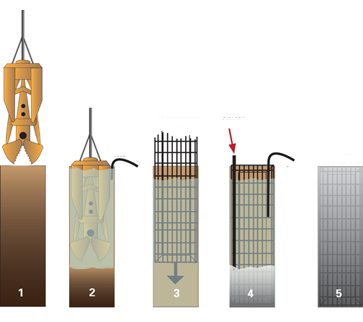
Brett Miller
Construction
Research | Retaining Structures
The Office Building
Washington, D.C.
Presentation Outline
Project Overview
Research | Retaining Structures
Analysis 1 | Foundation Walls
Cost
Schedule
Conclusion
Analysis 2 | Neighboring Foundation Support
Cost
Schedule
Conclusion
Analysis 3 | Value Engineering
Electrical Breadth | Sizing wire/Busway
Cost
Schedule
Conclusion
Conclusion & Recommendations
Acknowledgements
 | Advantages | Disadvantages
Sheet Piling (A) | Watertight Excavation | Costly Time Consuming
Soldier Piles and Lagging (B) | Less Expensive Faster | Loud Installation Not Watertight
Concrete Slurry Walls (C) | Watertight Extreme Depths Foundation Walls | Extremely Costly Time Consuming
Top Down Construction (D) | Fast Ground Stability | Geotech. Considerations
A
B
D
C

Slide 5
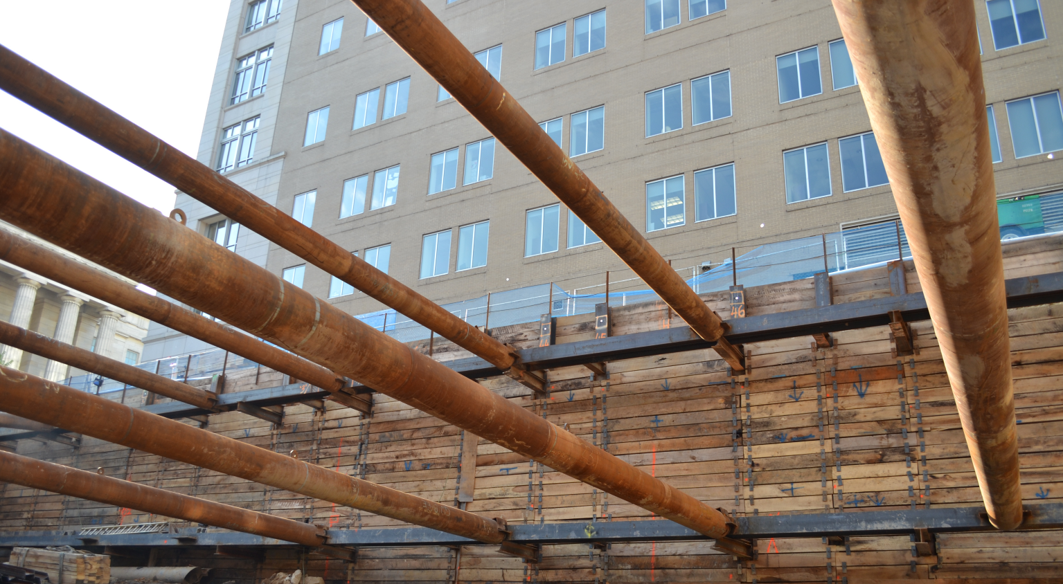
Brett Miller
Construction
Analysis 1 | Foundation Walls
The Office Building
Washington, D.C.
Presentation Outline
Project Overview
Research | Retaining Structures
Analysis 1 | Foundation Walls
Cost
Schedule
Conclusion
Analysis 2 | Neighboring Foundation Support
Cost
Schedule
Conclusion
Analysis 3 | Value Engineering
Electrical Breadth | Sizing wire/Busway
Cost
Schedule
Conclusion
Conclusion & Recommendations
Acknowledgements
Problem Identification
Extensive support of excavation
60 Foundation wall box-outs
Formwork time/cost
Potential Solutions
Replace CIP with shotcrete to reduce formwork

Slide 6
Brett Miller
Construction
Analysis 1 | Foundation Walls
The Office Building
Washington, D.C.
Presentation Outline
Project Overview
Research | Retaining Structures
Analysis 1 | Foundation Walls
Cost
Schedule
Conclusion
Analysis 2 | Neighboring Foundation Support
Cost
Schedule
Conclusion
Analysis 3 | Value Engineering
Electrical Breadth | Sizing wire/Busway
Cost
Schedule
Conclusion
Conclusion & Recommendations
Acknowledgements
Total Cost
Cast-in-Place | $314,943.96
Shotcrete | $237,816.54
Savings | $77,127.42
24.5% Savings

Slide 7
Brett Miller
Construction
Analysis 1 | Foundation Walls
The Office Building
Washington, D.C.
Presentation Outline
Project Overview
Research | Retaining Structures
Analysis 1 | Foundation Walls
Cost
Schedule
Conclusion
Analysis 2 | Neighboring Foundation Support
Cost
Schedule
Conclusion
Analysis 3 | Value Engineering
Electrical Breadth | Sizing wire/Busway
Cost
Schedule
Conclusion
Conclusion & Recommendations
Acknowledgements
Final Schedule
Cast-in-Place | 48 Days
Shotcrete | 15 Days
Savings | 33 Days
68.8% Savings

Slide 8
Brett Miller
Construction
Analysis 1 | Foundation Walls
The Office Building
Washington, D.C.
Presentation Outline
Project Overview
Research | Retaining Structures
Analysis 1 | Foundation Walls
Cost
Schedule
Conclusion
Analysis 2 | Neighboring Foundation Support
Cost
Schedule
Conclusion
Analysis 3 | Value Engineering
Electrical Breadth | Sizing wire/Busway
Cost
Schedule
Conclusion
Conclusion & Recommendations
Acknowledgements
Cast-in-Place
Shotcrete
$77,000
33 Days

Slide 9
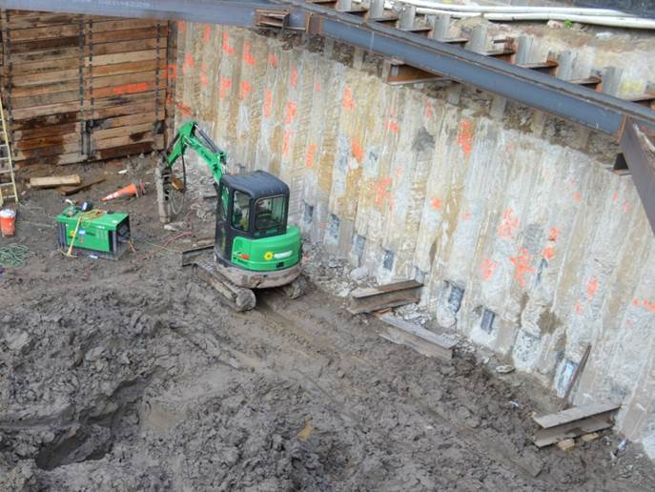
Brett Miller
Construction
Analysis 2 | Neighboring Foundation Support
The Office Building
Washington, D.C.
Presentation Outline
Project Overview
Research | Retaining Structures
Analysis 1 | Foundation Walls
Cost
Schedule
Conclusion
Analysis 2 | Neighboring Foundation Support
Cost
Schedule
Conclusion
Analysis 3 | Value Engineering
Electrical Breadth | Sizing wire/Busway
Cost
Schedule
Conclusion
Conclusion & Recommendations
Acknowledgements
Problem Identification
Historic building on West property line
Foundation needs supported
Secant Wall duration
Potential Solutions
Replace Secant Wall with Slurry Wall

Slide 10
Brett Miller
Construction
Analysis 2 | Neighboring Foundation Support
The Office Building
Washington, D.C.
Presentation Outline
Project Overview
Research | Retaining Structures
Analysis 1 | Foundation Walls
Cost
Schedule
Conclusion
Analysis 2 | Neighboring Foundation Support
Cost
Schedule
Conclusion
Analysis 3 | Value Engineering
Electrical Breadth | Sizing wire/Busway
Cost
Schedule
Conclusion
Conclusion & Recommendations
Acknowledgements
Total Cost
Secant Wall | $551,000
24” Slurry Wall | $744,000
Additional Costs | $193,000
+
35% Increase

Slide 11
Brett Miller
Construction
Analysis 2 | Neighboring Foundation Support
The Office Building
Washington, D.C.
Presentation Outline
Project Overview
Research | Retaining Structures
Analysis 1 | Foundation Walls
Cost
Schedule
Conclusion
Analysis 2 | Neighboring Foundation Support
Cost
Schedule
Conclusion
Analysis 3 | Value Engineering
Electrical Breadth | Sizing wire/Busway
Cost
Schedule
Conclusion
Conclusion & Recommendations
Acknowledgements
Final Schedule
Secant Wall | 15 Days
Slurry Wall | 15 Days
Savings | 0 Days
0% Savings

Slide 12
Brett Miller
Construction
Analysis 2 | Neighboring Foundation Support
The Office Building
Washington, D.C.
Presentation Outline
Project Overview
Research | Retaining Structures
Analysis 1 | Foundation Walls
Cost
Schedule
Conclusion
Analysis 2 | Neighboring Foundation Support
Cost
Schedule
Conclusion
Analysis 3 | Value Engineering
Electrical Breadth | Sizing wire/Busway
Cost
Schedule
Conclusion
Conclusion & Recommendations
Acknowledgements
Secant Wall
24” Slurry Wall
$193,000
0 Days

Slide 13
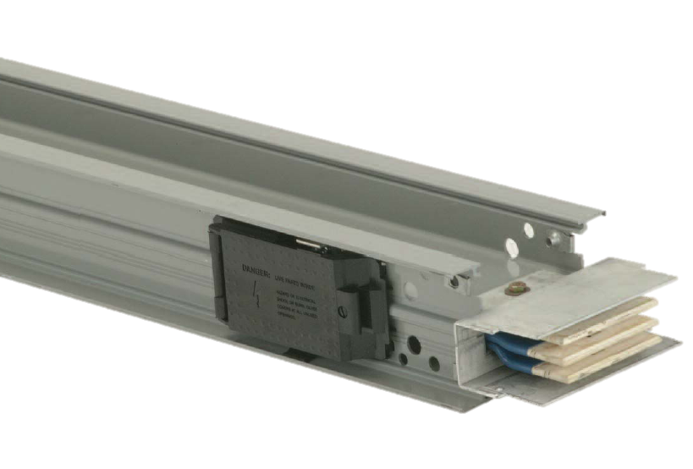
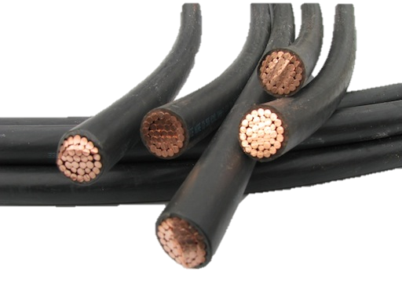
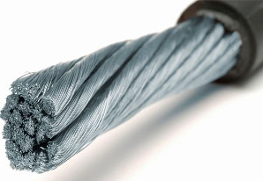
Brett Miller
Construction
Analysis 3 | Value Engineering
The Office Building
Washington, D.C.
Presentation Outline
Project Overview
Research | Retaining Structures
Analysis 1 | Foundation Walls
Cost
Schedule
Conclusion
Analysis 2 | Neighboring Foundation Support
Cost
Schedule
Conclusion
Analysis 3 | Value Engineering
Electrical Breadth | Sizing wire/Busway
Cost
Schedule
Conclusion
Conclusion & Recommendations
Acknowledgements
Problem Identification
Unforeseen costs
Over budget
Expensive copper feeder
Potential Solutions
Replace copper wiring with less expensive system

Slide 14
Brett Miller
Construction
Analysis 3 | Value Engineering
The Office Building
Washington, D.C.
Presentation Outline
Project Overview
Research | Retaining Structures
Analysis 1 | Foundation Walls
Cost
Schedule
Conclusion
Analysis 2 | Neighboring Foundation Support
Cost
Schedule
Conclusion
Analysis 3 | Value Engineering
Electrical Breadth | Sizing wire/Busway
Cost
Schedule
Conclusion
Conclusion & Recommendations
Acknowledgements
Sizing Aluminum Wiring
Sizing Aluminum Busway
$$2500 A Load per Switchboard$$
$$Table 310.15 \left(B\right)\left(16\right)$$
$$↳500 kcmil→310 A$$
$\frac{2500 A}{310 A}=8.06→9 Sets∗310 A=2790 A$
$$Table 250−66$$
$$↳500 kcmil_{AL}→1/0 AWG_{AL}$$
$$Table C.1$$
$↳\left(4\right)500 kcmil+\left(1\right)1/0→4" Conduit$
$$2500 A Load per Switchboard$$
$$GE Spectra Series Busway$$
$$Table 8.1$$
$↳\left(2\right) bars→11/8" Thick per Phase \& Neutral$
$$Table 11.1$$
$↳4.5"×15.0"$
15.0”
4.5”

Slide 15
Brett Miller
Construction
Analysis 3 | Value Engineering
The Office Building
Washington, D.C.
Total Cost
Copper Wiring | $330,436.85
Aluminum Wiring | $313,076.71
Aluminum Busway | $225,346.06
Presentation Outline
Project Overview
Research | Retaining Structures
Analysis 1 | Foundation Walls
Cost
Schedule
Conclusion
Analysis 2 | Neighboring Foundation Support
Cost
Schedule
Conclusion
Analysis 3 | Value Engineering
Electrical Breadth | Sizing wire/Busway
Cost
Schedule
Conclusion
Conclusion & Recommendations
Acknowledgements
5% Savings
32% Savings

Slide 16
Brett Miller
Construction
Analysis 3 | Value Engineering
The Office Building
Washington, D.C.
Final Schedule
Copper Wiring | 46 Days
Aluminum Wiring | 50 Days
Aluminum Busway | 41 Days
Presentation Outline
Project Overview
Research | Retaining Structures
Analysis 1 | Foundation Walls
Cost
Schedule
Conclusion
Analysis 2 | Neighboring Foundation Support
Cost
Schedule
Conclusion
Analysis 3 | Value Engineering
Electrical Breadth | Sizing wire/Busway
Cost
Schedule
Conclusion
Conclusion & Recommendations
Acknowledgements
Aluminum Wiring Schedule Increase
Aluminum Busway Schedule Savings
+
8.7% Increase
10.9% Savings

Slide 17
Brett Miller
Construction
Analysis 3 | Value Engineering
The Office Building
Washington, D.C.
Presentation Outline
Project Overview
Research | Retaining Structures
Analysis 1 | Foundation Walls
Cost
Schedule
Conclusion
Analysis 2 | Neighboring Foundation Support
Cost
Schedule
Conclusion
Analysis 3 | Value Engineering
Electrical Breadth | Sizing wire/Busway
Cost
Schedule
Conclusion
Conclusion & Recommendations
Acknowledgements
Copper Wiring
Aluminum Wiring
Copper Wiring
Aluminum Busway
$105,000
5 Days
$17,000
4 Days

Slide 18
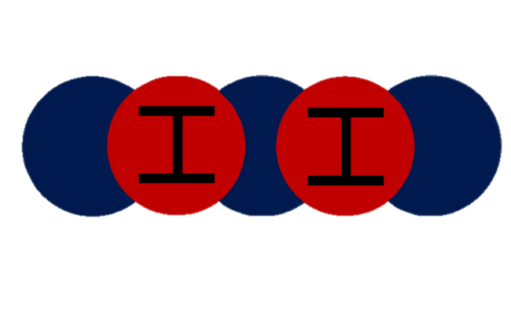
Brett Miller
Construction
Conclusion & Recommendations
The Office Building
Washington, D.C.
Analysis 1 | Foundation Walls
Presentation Outline
Project Overview
Research | Retaining Structures
Analysis 1 | Foundation Walls
Cost
Schedule
Conclusion
Analysis 2 | Neighboring Foundation Support
Cost
Schedule
Conclusion
Analysis 3 | Value Engineering
Electrical Breadth | Sizing wire/Busway
Cost
Schedule
Conclusion
Conclusion & Recommendations
Acknowledgements
Cost Impact: Save $77,000
Schedule: Save 33 Days
Recommendation: Select Shotcrete
Analysis 3 | Value Engineering
Total Savings
Cost Impact: Aluminum Wire Saves $17,000
Aluminum Busway Saves $105,000
Schedule: Aluminum Wire Takes 4 More Days
Aluminum Busway Saves 5 Days
Recommendation: Select Aluminum Busway
$182,000
38 Days
Analysis 2 | Neighboring Foundation Support
Cost Impact: $193,000 More Expensive
Schedule: No Advantage
Recommendation: Select Secant Wall

Slide 19
Brett Miller
Construction
Acknowledgements
The Office Building
Washington, D.C.
Special Thanks
The DAVIS Project Team
Will Cox – DAVIS Project Manager
Drew Heilman – DAVIS Project Engineer
Rebecca Nordby – Balfour Beatty Project Executive
PACE Industry Members
Friends and Family
Industry Acknowledgements
Academic Acknowledgements
Dr. Ed Gannon
Dr. Robert Leicht
Dr. Craig Dubler

Slide 21
Brett Miller
Construction
Appendix A | Foundation Walls
The Office Building
Washington, D.C.
System | Material | Labor | Equipment | Total
Cast-in-Place | $229,583.19 | $69,120.00 | $16,240.77 | $314,943.96
Shotcrete | $186,587.54 | $30,240.00 | $20,989.00 | $237,816.54
Savings | $42,995.65 | $38,880.00 | -$4,748.23 | $77,127.42
System | P1 | P2 | P3 | Total
Cast-in-Place | 12 | 12 | 24 | 48
Shotcrete | 4.5 | 4 | 6.5 | 15
Savings | 19.5 | 8 | 5.5 | 33

Slide 22
Brett Miller
Construction
Appendix A | Foundation Walls
The Office Building
Washington, D.C.
Shotcrete Cost Breakdown
Floor | Volume (cu yd) | Concrete Unit Cost ($/cu yd) | Concrete Cost | Rebar Cost | Total Material Cost | Labor Unit Cost ($/Day) | Labor Cost | Equipment Unit Cost ($/cu yd) | Equipment Cost | Total
P3 | 234 | $157.32 | $36,812.88 | $21,021.39 | $57,834.27 | $2,016.00 | $9,072.00 | $27.80 | $6,505.20 | $73,411.47
P2 | 216 | $157.32 | $33,981.12 | $18,987.06 | $52,968.18 | $2,016.00 | $8,064.00 | $27.80 | $6,004.80 | $67,036.98
P1 | 305 | $157.32 | $47,982.60 | $27,802.49 | $75,785.09 | $2,016.00 | $13,104.00 | $27.80 | $8,479.00 | $97,368.09
Total | 755 |  | $118,776.60 | $67,810.94 | $186,587.54 |  | $30,240.00 |  | $20,989.00 | $237,816.54
Cast-in-Place Concrete Cost Breakdown
Floor | Volume (cu yd) | Concrete Unit Cost ($/cu yd) | Concrete Cost | Formwork Unit Cost ($/ft) | Formwork Cost | Rebar Cost | Total Material Cost | Labor Unit Cost ($/Day) | Labor Cost | Equipment Unit Cost ($/cu yd) | Equipment Cost | Total
P3 | 205 | 118.41 | $24,274.05 | $78.37 | $25,901.29 | $21,021.39 | $71,196.73 | $1,440.00 | $34,560.00 | 24.57 | 5036.85 | $110,793.58
P2 | 188 | 118.41 | $22,261.08 | $78.37 | $23,746.11 | $18,987.06 | $64,994.25 | $1,440.00 | $17,280.00 | 24.57 | 4619.16 | $86,893.41
P1 | 268 | 118.41 | $31,733.88 | $78.37 | $33,855.84 | $27,802.49 | $93,392.21 | $1,440.00 | $17,280.00 | 24.57 | 6584.76 | $117,256.97
Total: |  |  | $78,269.01 |  | $83,503.24 | $67,810.94 | $229,583.19 |  | $69,120.00 |  | $16,240.77 | $314,943.96
CIP Schedule Breakdown
Floor | Wall Length (ft) | Duration (Day)
P3 | 330.5 | 24
P2 | 303.0 | 12
P1 | 432.0 | 12
Total | 1066 | 48
Shotcrete Schedule Breakdown
Floor | Volume (cu yd) | Duration (Day)
P3 | 234 | 4.5
P2 | 216 | 4
P1 | 305 | 6.5
Total | 755 | 15

Slide 23
Brett Miller
Construction
Appendix B | Neighboring Foundation
The Office Building
Washington, D.C.
Cost Comparison
System | Material | Labor / Manpower | Equipment | Transportation / Mobilization | Grand Total
Secant Wall System | $230,000 | $117,000 | $78,000 | $126,000 | $551,000
24" thick Slurry Wall | $408,000 | $86,000 | $70,000 | $180,000 | $744,000
Savings | -$178,000 | $31,000 | $8,000 | -$54,000 | -$193,000
Schedule Comparison
System | Duration
Secant Wall System | Mob/demob | 1 Week
 | Wall | 2 Weeks
24" thick Slurry Wall | Mob/demob | 2 Weeks
 | Wall | 1 Week

Slide 24
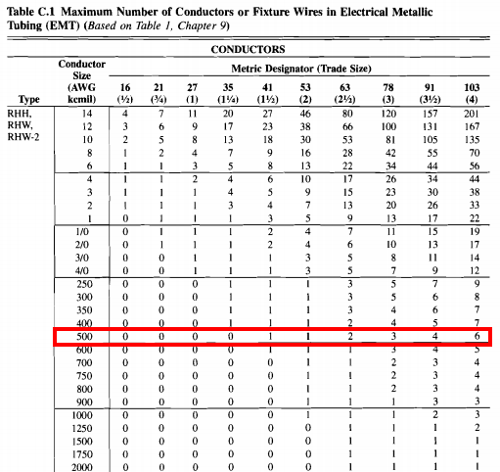
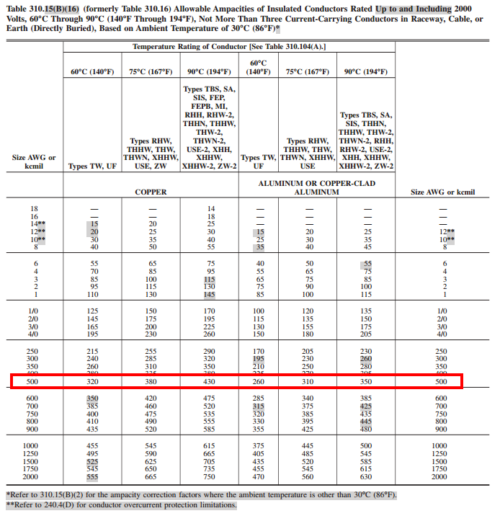
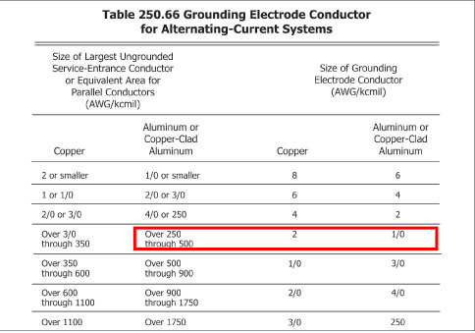
Brett Miller
Construction
Appendix C | Electrical Breadth
The Office Building
Washington, D.C.

Slide 25
Brett Miller
Construction
Appendix D | Value Engineering
The Office Building
Washington, D.C.
Copper Wiring Breakdown
Aluminum Wiring Breakdown
Aluminum Busway Breakdown
Master Format Code | Description | Unit | Length | Material Unit Cost | Total Material | Labor Unit Cost | Total Labor | Total | Crew | # of Crews | Labor Hours | Duration (hrs)
260519900490 | 500 kcmil Copper Conductor | CLF | 96.46 | $1,186.75 | $114,473.91 | $833.04 | $80,355.04 | $194,828.94 | 3 Elec | 3 | 5 | 161
260519900260 | 1/0 kcmil Copper Grounding Conductor | CLF | 24.115 | $253.51 | $6,113.39 | $402.48 | $9,705.81 | $15,819.20 | 2 Elec | 3 | 2.424 | 20
260533131140 | 4" Diameter Metal Conduit | LF | 2411.5 | $25.25 | $60,890.38 | $38.07 | $91,805.81 | $152,696.18 | 2 Elec | 3 | 0.229 | 185
Total |  |  |  |  | $181,477.67 |  | $148,959.18 | $330,436.85 |  |  |  | 366
Master Format Code | Description | Unit | Length | Material Unit Cost | Total Material | Labor Unit Cost | Total Labor | Total | Crew | # of Crews | Labor Hours | Duration (hrs)
260519900800 | 500 kcmil Aluminum Conductor | C.L.F. | 124.02 | $398.95 | $49,477.78 | $221.52 | $27,472.91 | $76,950.69 | 3 Elec | 3 | 4 | 166
260519900620 | 1/0 Aluminum Grounding Conductor | C.L.F. | 31.005 | $111.10 | $3,444.66 | $111.28 | $3,450.24 | $6,894.89 | 2 Elec | 3 | 2 | 21
260533131140 | 4" Diameter Metal Conduit | L.F. | 3100.5 | $25.25 | $78,287.63 | $38.07 | $118,036.04 | $196,323.66 | 2 Elec | 3 | 0.2 | 207
Total |  |  |  |  | $131,210.06 |  | $181,866.65 | $313,076.71 |  |  |  | 394
Master Format Code | Description | Unit | Length | Material Unit Cost | Total Material | Labor Unit Cost | Total Labor | Total | Crew | # of Crews | Labor Hours | Duration (hrs)
262513104620 | Feeder Al Busway 2500 amp | L.F | 200.5 | $484.80 | $97,202.40 | $147.68 | $29,609.84 | $126,812.24 | 2 Elec | 2 | 1.333 | 134
262513100330 | Plug-in Al Busway 2500 amp | L.F | 144 | $398.95 | $57,448.80 | $126.88 | $18,270.72 | $75,719.52 | 2 Elec | 2 | 1.143 | 83
262513106470 | Busway End Box 2500 amp | Ea. | 2 | $1,136.25 | $2,272.50 | $738.40 | $1,476.80 | $3,749.30 | 2 Elec | 1 | 13.333 | 27
262513105520 | Busway Elbow 2500 amp | Ea. | 10 | $1,464.50 | $14,645.00 | $442.00 | $4,420.00 | $19,065.00 | 2 Elec | 1 | 8 | 80
Total |  |  |  |  | $171,568.70 |  | $53,777.36 | $225,346.06 |  |  |  | 324

